Slide 1
Patient Safety & Quality Indicator (PSQI) Deep Dive Central Line-Associated Bloodstream Infections (CLABSI)
Stephanie L. McNeese
Texas Tech University Health Sciences Center
NURS 5332 – Informatics II
Dr. Steph Hoelscher
December 1, 2025

Slide 2
Introduction
Central Line-Associated Bloodstream Infections (CLABSI)
Patient Safety Indicator (PSI) 07 measures hospital-acquired central venous catheter-related bloodstream infections and serves as a critical patient-safety indicator for preventing avoidable harm in medical, surgical, and obstetric care (Agency for Healthcare Research and Quality [AHRQ], 2025).
CLABSI can increase costs, length of stay (LOS), and mortality risk (AHRQ, 2024)
Comprise a significant portion of hospital-acquired infections (HAI) at 8.3%
COVID-19 disrupted CLABSI reporting, reinforcing the need for steady monitoring (Sapiano et al., 2025)
Chosen due to its strong relevance to infection prevention and quality improvement
Notes:
PSI-07, the Central Venous Catheter-Related Bloodstream Infection Rate, is a nationally recognized patient-safety indicator that measures hospital-acquired bloodstream infections associated with central lines, and I selected it because it directly reflects the quality and safety of clinical care.
CLABSI can increase costs, LOS, and mortality risk (AHRQ, 2024)
CLABSIs require intensive treatment, extend hospitalization, and significantly raise the risk of severe complications or death.
Comprise 8.3% of all hospital-acquired infections (AHRQ, 2024)
They remain one of the most common preventable HAIs, showing ongoing gaps in central-line safety practices (Odada et al., 2023).
COVID-19 disrupted CLABSI reporting and outcomes
Pandemic-related strain led to higher infection rates and inconsistent reporting, emphasizing the need for reliable surveillance even during emergencies (Sapiano et al., 2025).
Chosen for strong relevance to infection prevention
CLABSI data directly supports quality-improvement work and reflects how clinical workflows, device care, and nursing practice impact patient safety (Odada et al., 2023).

Slide 3
Indicator Definition
Operational Definition
PSI-07 identifies hospital-acquired central line infections using secondary diagnosis codes, after applying strict inclusion and exclusion criteria (AHRQ, 2025)
Measurement Method
Cases meeting denominator rules are counted after exclusions are applied (e.g., cancer, immunocompromised, <2-day LOS, present on admission)
Infection cases are counted after exclusions applied to become numerator
Final rate is reported per 1,000 qualifying discharges
Governing Organization AHRQ sets the specifications and updates PSI-07 through its national Patient Safety Indicators system.
Notes:
Operational definition: PSI-07 focuses on central venous catheter–related bloodstream infections that occur during hospitalization, identified through secondary diagnosis codes and inclusion/exclusion rules.
Measurement method: Uses ICD-10-CM coding to define eligible cases, filter out principal infections and high-risk populations (cancer, immunocompromised), and calculate a standardized rate per 1,000 discharges.
Governing organization: AHRQ sets the specifications and updates PSI-07 through its national Patient Safety Indicators system.

Slide 4
Indicator Definition
DENOMINATOR
Hospital Discharges meeting PSI-07 criteria
Exclude POA Infections, Cancer, Immunocompromised Dx
Exclude LOS<2 days, missing core data, ungroupable DRG
NUMERATOR
Hospital Discharges with CLABSI
in “Preventable” Range
Counts secondary diagnoses of catheter infections (AHRQ, 2025)
Includes adult medical, surgical, and obstetric discharges.
Excludes cancer and immunocompromised patients.
Excludes patients under 18 years of age (unless obstetric)
Excludes short stays <2 days.
Excludes infections present on admission.
Notes:
Around 20% of HAI are considered preventable, the rest are less than preventable due to factors like immunocompromised state (Zhang, 2024). The exclusions in the PSI-07 help to identify CLABSI that occur in the “preventable” range of patients.
Counts infections only among discharges where catheter-related sepsis is coded as a secondary ICD-10-CM diagnosis (AHRQ, 2025).
Applies to medical, surgical, and obstetric discharges, including adults 18+ and all pregnancy-related cases.
Excludes patients with cancer, immunocompromised conditions, patients under the age of 18 (unless obstetric), ungroupable Diagnosis-Related Groups (DRG), or missing certain demographic data.
Removes discharges with stays under two days, since these cannot reflect typical hospital-acquired infections.
Excludes cases central line infections documented as present on admission (POA).
Note: I used ChatGPT to come up with the idea for the funnel diagram (OpenAI, 2025). However, I created the diagram myself using SmartArt.

Slide 5
Data Source and Collection
Centers for Medicare & Medicaid Services (CMS) - CMS Hospital Compare: Healthcare Associated Infections-Hospital data set for FY2024 (covering October 1, 2023 – September 30, 2024)
Agency for Healthcare Research and Quality (AHRQ) - 2017 national report on cost & mortality of HAC (utilizing 2006-2012 data)
Notes:
I attempted to retrieve case specific data from the Texas Department of State Health Services (TXDSHS) utilizing Texas Health Care Information Collection (THCIC), However, I found the data for this particular indicator to be difficult to isolate. Therefore, I did not use it.

Slide 6
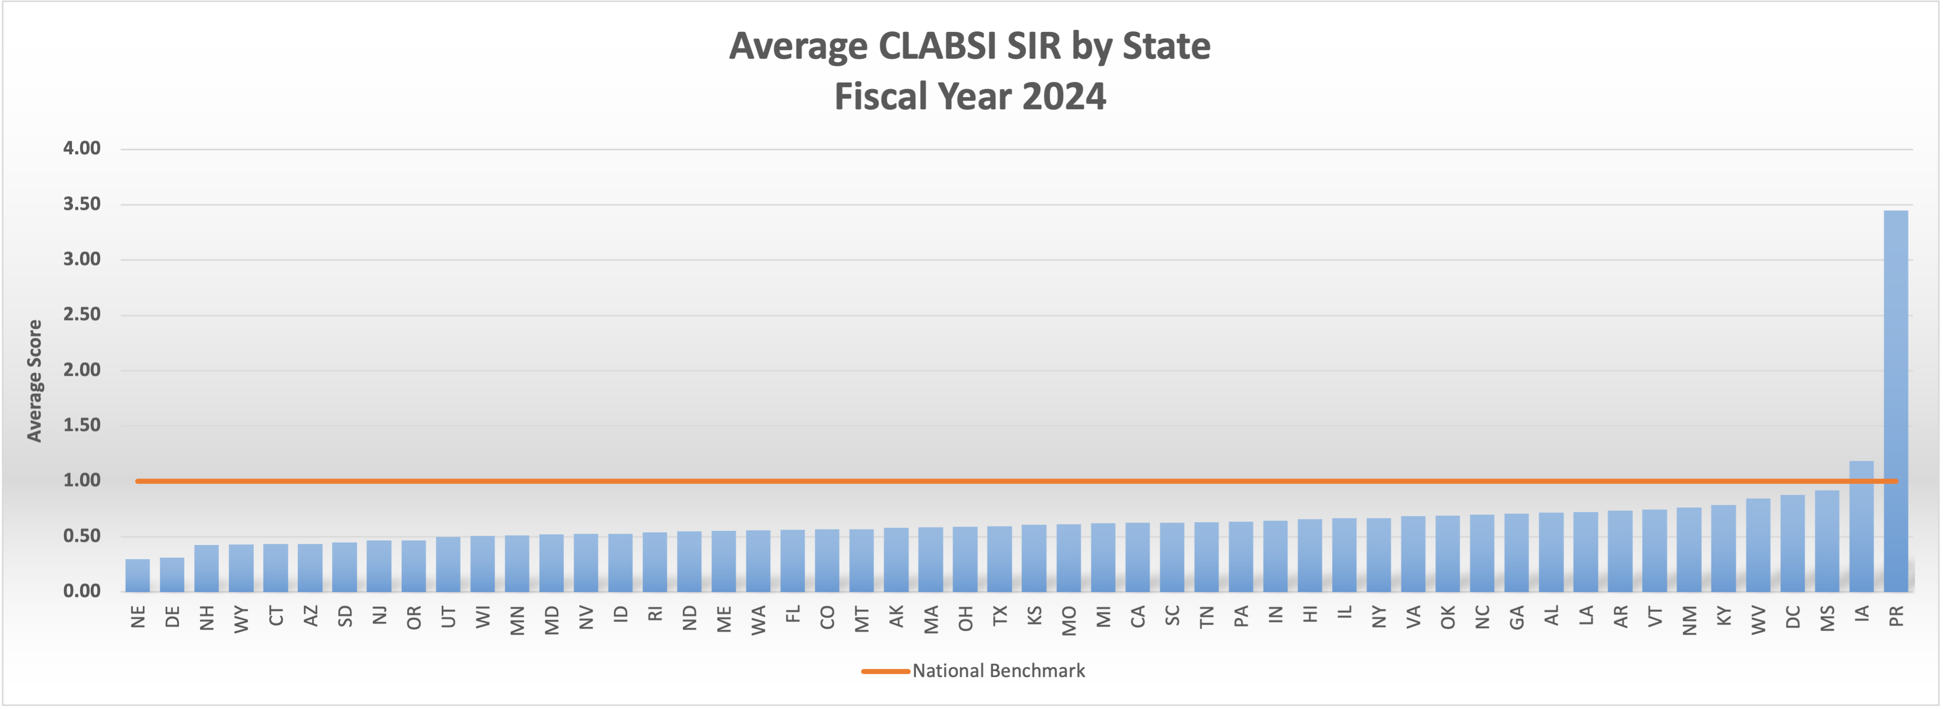
Data Analysis and Findings
Figure 1. Average CLABSI SIR by state. Data visualization created by the author in Excel using CMS data.
Source: McNeese, S. (2025). (Data derived from CMS, 2025)
Notes:
When I made this chart, it completely changed the direction I was going with this assignment. This data was obtained from CMS, and only reflects the most recent fiscal year of 2024. As you can see, nearly every state performed better than the national benchmark, with the exception of Iowa, which performed slightly worse (CMS, 2025). However, let’s take a look at Puerto Rico! Puerto Rico CLABSI rates far exceeded the national benchmark. Their Standardized Infection Ratio (SIR) score was nearly 3.5 times higher than the worst performing state. This is only the average; many hospitals scored far worse. San Juan Municipal Hospital in San Juan, Puerto Rico had an astounding CLABSI SIR score of 12.64.
After a thorough Pubmed search, this data from CMS was the only current scholarly data I was able to find regarding CLABSI rates in Puerto Rico.

Slide 7
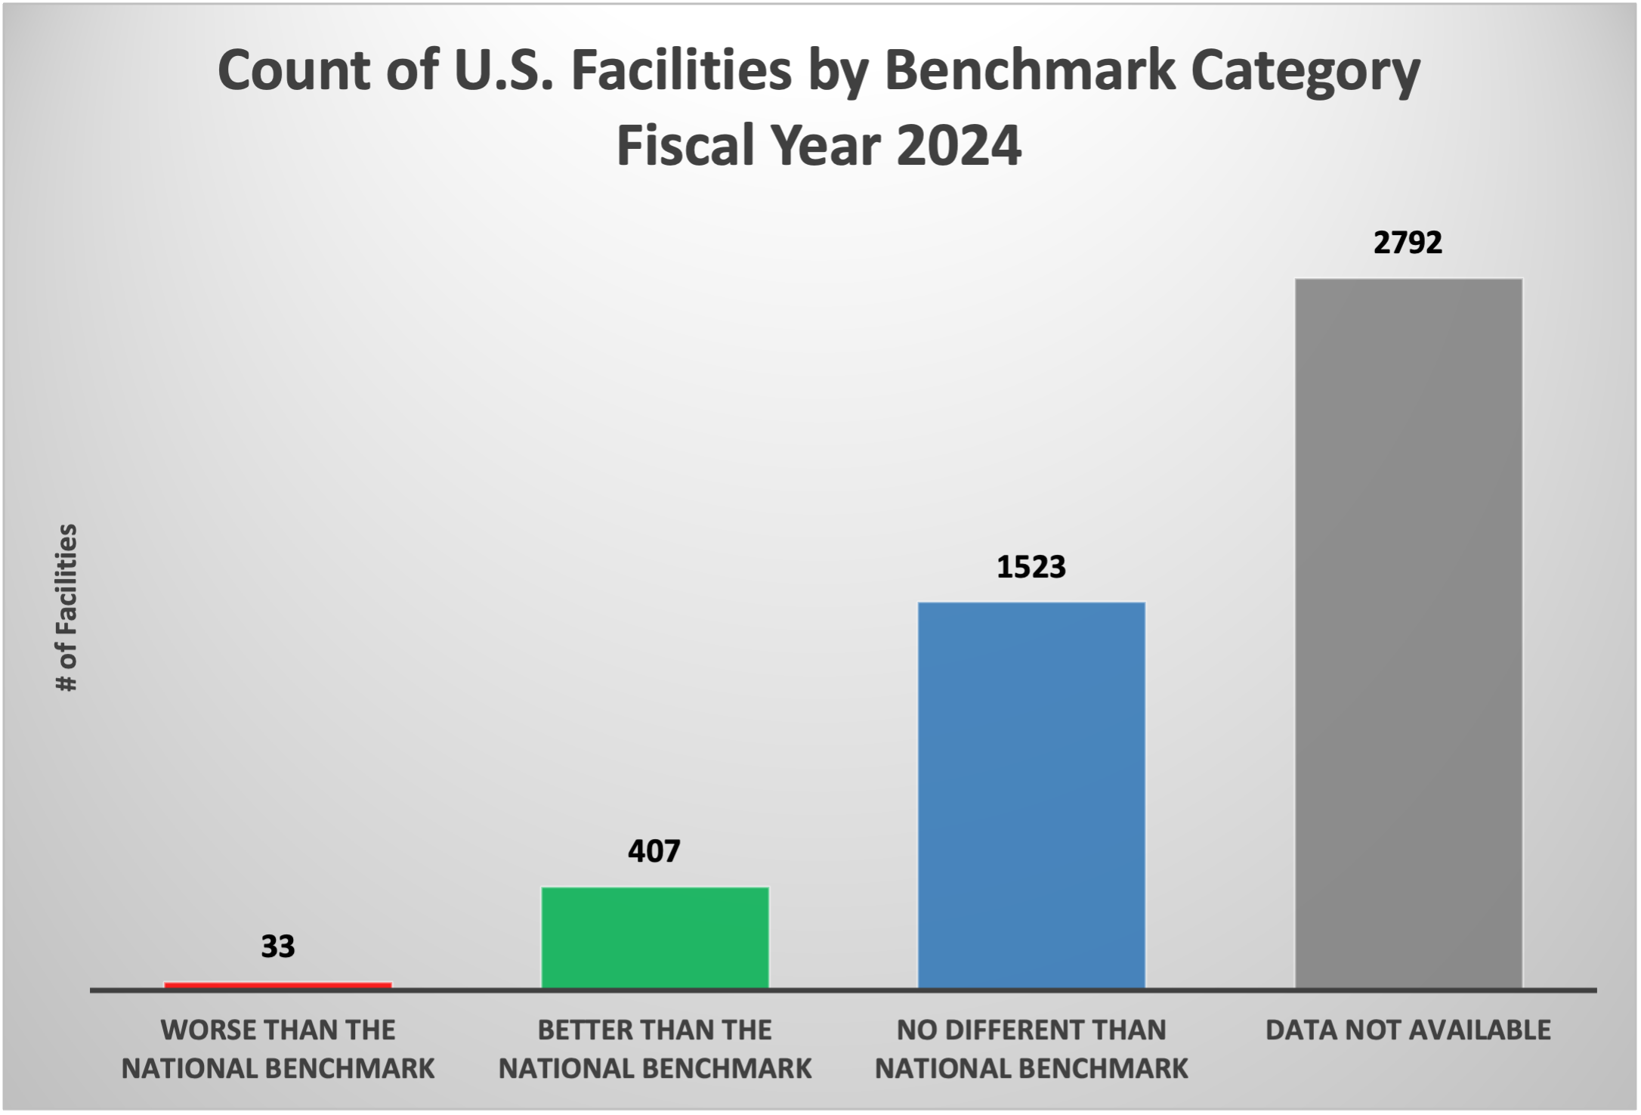
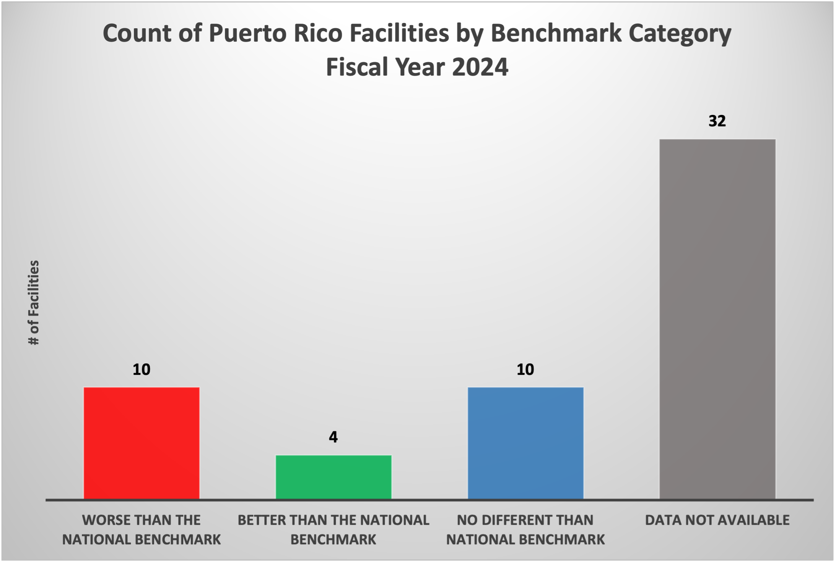
Data Analysis and Findings
Figure 2. Count of U.S. facilities by benchmark category 2024. Data visualization created by the author in Excel using CMS data.
Source: McNeese, S. (2025). (Data derived from CMS, 2025)
Figure 3. Count of Puerto Rico facilities by benchmark category 2024. Data visualization created by the author in Excel using CMS data.
Source: McNeese, S. (2025). (Data derived from CMS, 2025)
Notes:
Look at the difference between these two charts. On the left is benchmark comparison of hospitals across the entire United States and Puerto Rico. When looking at the U.S. as a whole, most of the reporting facilities score better than or no different from the national benchmark. However, the chart on the right displays Puerto Rico data only, and the disparity is plain to see: Puerto Rico is far below the continental U.S. when it comes to central-line infections.

Slide 8
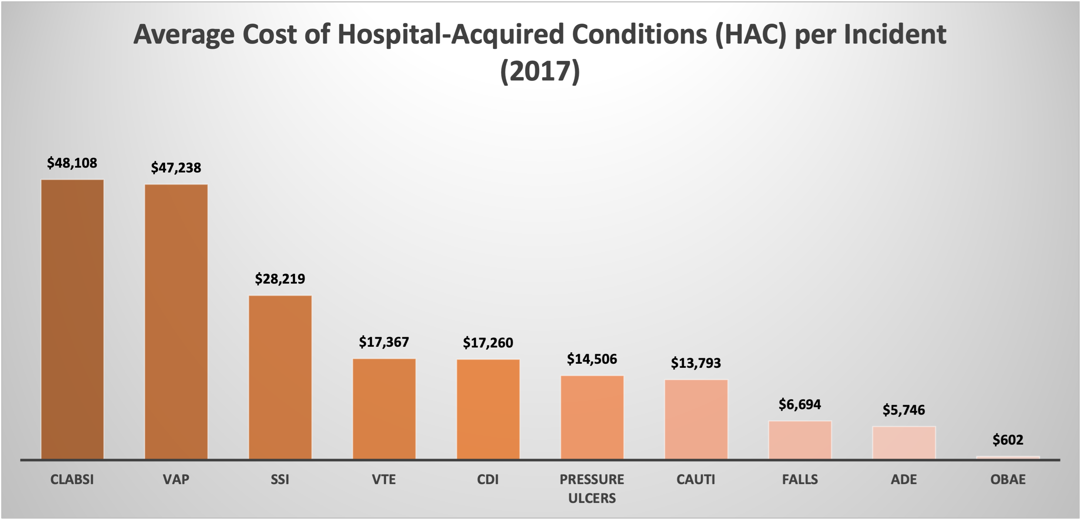
Implications for Practice
Figure 4. Average cost of HAC per incident (2017). Data visualization created by the author in Excel using AHRQ data.
Source: McNeese, S. (2025). (Data derived from AHRQ, 2017)
Notes:
This chart shows that out of all the hospital acquired conditions reported, CLABSI tend to be the most expensive, just beating out ventilator-associated pneumonia. The AHRQ 2017 HAC cost model is still widely referenced because it is the most recent report of its type; however, its dollar estimates are outdated given increases in hospital inflation, labor costs, and post-pandemic shifts in acuity. More recent studies suggest significantly higher per-event costs for HAIs such as CLABSI, although I was not able to locate a post-pandemic report of this kind. More recent research compiling and comparing the costs of HACs would be invaluable. Perhaps it could be considered as a post-graduate doctoral project.
Adverse Drug Events (ADE)
Catheter-Associated Urinary Tract Infections (CAUTI)
Central Line-Associated Bloodstream Infections (CLABSI)
Falls
Obstetric Adverse Events (OBAE)
Pressure Ulcers
Surgical Site Infections (SSI)
Ventilator-Associated Pneumonia (VAP)
Venous Thromboembolism (VTE)
C. difficile Infections (CDI)
https://www.ahrq.gov/hai/pfp/haccost2017-results.html

Slide 9
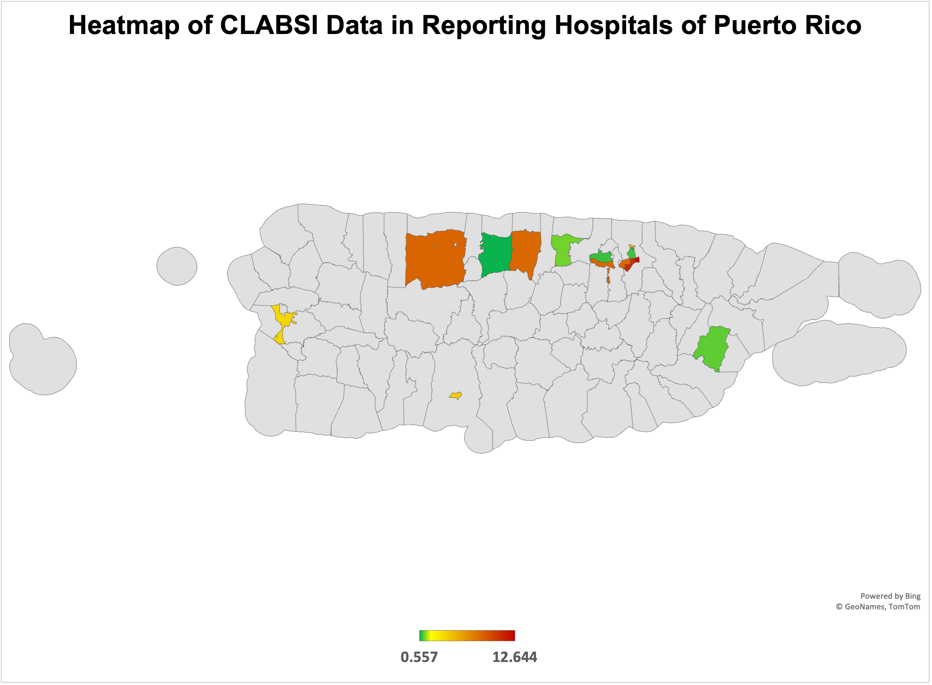
Data Analysis and Findings
Figure 5. Heatmap of CLABSI in Puerto Rico Hospitals. Data visualization created by the author in Excel using CMS data.
Source: McNeese, S. (2025). (Data derived from CMS, 2025)
Notes:
Data from Puerto Rico is very sparse. Nearly half of the hospitals contained in the CMS data set did not report any CLABSI info. This may be because not all hospitals use central lines. Additionally, just before the reporting period, Puerto Rico was hit by Hurricane Fiona, a major disaster that devastated infrastructure across the island and widely disrupted public health and healthcare systems across the territory (McSorley et al., 2024). However, without the previous years of data, it is not possible to compare and see if the 2024 fiscal year was statistically worse than other years due to disaster recovery or other factors.

Slide 10
Implications for Practice
CLABSI Disparities in Puerto Rico
Puerto Rico is a U.S. territory, and its residents are U.S. citizens (U.S. Citizenship and Immigration Services, 2025).
CLABSI rates show significant disparities compared to stateside facilities (CMS, 2025).
Research on CLABSI and other health topics in Puerto Rico is limited, contributing to disparities (McSorley et al., 2025).
Puerto Rico has higher rates of comorbidities that increase infection risk, including:
Diabetes
Cardiovascular disease
Asthma
Hypertension
These combined factors create a high-risk environment for preventable HAIs and underscore the need for targeted surveillance and support.
Notes:
Puerto Rico may not be an official state, but the residents are citizens of the United States. There is a clear and vast disparity in CLABSI rates and research related to CLABSI rates in Puerto Rico. Not only that: residents of the territory have higher rates of many other comorbidities such as diabetes, cardiovascular disease, asthma, and hypertension (McSorley et al., 2024).
CLABSI Disparities in Puerto Rico
Puerto Rico is a U.S. territory, and its residents are U.S. citizens.
CLABSI rates show significant disparities compared to stateside facilities.
Research on CLABSI in Puerto Rico is limited, contributing to gaps in quality improvement efforts.
Puerto Rico experiences higher rates of key comorbidities that increase infection risk, including:
Diabetes
Cardiovascular disease
Asthma
Hypertension
These combined factors create a high-risk environment for preventable HAIs and underscore the need for targeted surveillance and support.

Slide 11
Recommendations
Strengthen surveillance using real-time SIR dashboards
Implement a standardized CLABSI prevention bundle
Implement targeted staff education to improve line-maintenance competency
(Odada et al.,2023; Sapiano et al., 2025)
Notes:
These recommendations are targeted toward CLABSI in Puerto Rico.
I don’t know what kind of standards Puerto Rican hospitals have when it comes to central-line maintenance. They may already have maintenance bundles in place; however, a thorough review and possible overhaul of existing practices may be of great help in reducing CLABSI rates in the territory. If they do not, implementing bundles would be of immense benefit. Al-Khawaja et al. (2021) demonstrated in their study that by implementing standardized CLABSI bundles in Bahrain hospitals, CLABSI rates were reduced to less than one-third of the pre-bundle rate. Therefore: my recommendations would be:
Implement a standardized CLABSI prevention bundle to ensure consistent use of evidence-based practices such as chlorhexidine prep, sterile technique, and daily review of line-necessity to reduce preventable infections (Odada et al., 2023).
Implement targeted staff education to improve line-maintenance competency - Regular refresher training, audits, and return demonstrations to address practice gaps and improve compliance to professional standards.
This recommendation is targeted toward the U.S and Puerto Rico.
Strengthen surveillance using real-time SIR dashboards to improve early detection of rising infection rates and reduce reporting gaps (Sapiano et al., 2025).
Note: I created the graphic myself using SmartArt. I utilized ChatGPT to create the thumbnail images (OpenAI, 2025).

Slide 12
Conclusion
CLABSI is still a major patient-safety issue, and the data show variation in both performance and reporting across the country since the 2020 pandemic (Sapiano et al., 2025). Puerto Rico stands out as an area where reporting gaps and higher comorbidity burdens create added risk (CMS, 2025). This data reinforces how important it is for health care organizations to stay consistent with prevention bundles, maintain consistent and evidence-based line-care practices, and make sure staff are confident in what proper maintenance looks like (Odada et al., 2023). Strengthening surveillance and giving teams timely, accurate data to work with will help identify problems early before they escalate.
Overall, these findings support a focused, evidence-based approach in assisting our U.S. territory of Puerto Rico. Make prevention practices consistent, invest in ongoing education, and improve monitoring so gaps in care can be addressed quickly. These strategies can reduce disparities and improve safety for patients in every setting.

Slide 13
Generative AI Attestation
I attest that I used a generative AI tool in accordance with course guidelines and assignment-specific permissions. I used ChatGPT (OpenAI, 2025) on November 24, 2025, to gather insights about CLABSI. The prompt(s) used included: “What are some insights that can be gained from this data, and what are the best charts to display that data?” and “I can’t find a more recent version of this report, can you?” I also asked ChatGPT to help me compare my presentation to the assignment rubric and to create thumbnail images for my SmartArt graphic.
All AI-generated content was critically reviewed, edited, and appropriately integrated with my own academic and clinical reasoning.

Slide 14
References
Agency for Healthcare Research and Quality. (2017, November). Estimating the additional hospital inpatient cost and mortality associated with selected hospital-acquired conditions. U.S. Department of Health and Human Services. https://www.ahrq.gov/hai/pfp/haccost2017-results.html
Agency for Healthcare Research and Quality. (2024, March). Chartbook on patient safety. U.S. Department of Health and Human Services. https://www.ahrq.gov/sites/default/files/wysiwyg/research/findings/nhqrdr/chartbooks/patientsafety/2023qdr-patient-safety-chartbook-final.pdf
Agency for Healthcare Research and Quality. (2025, August). Patient safety indicator 07 (PSI 07) central venous catheter related bloodstream infection rate. U.S. Department of Health and Human Services. https://qualityindicators.ahrq.gov/Downloads/Modules/PSI/V2025/TechSpecs/PSI_07_Central_Venous_Catheter-Related_Blood_Stream_Infection_Rate.pdf
Al-Khawaja, S., Saeed, N. K., Al-Khawaja, S., Azzam, N., & Al-Biltagi, M. (2021). Trends of central line-associated bloodstream infections in the intensive care unit in the Kingdom of Bahrain: Four years' experience. World Journal of Critical Care Medicine, 10(5), 220–231. https://doi.org/10.5492/wjccm.v10.i5.220
Centers for Medicare & Medicaid Services. (2025, August 6). Healthcare associated infections - Hospital [Data set]. Department of Health & Human Services. ​ https://data.cms.gov/provider-data/dataset/77hc-ibv8
McSorley, A. M., Rivera-González, A. C., Mercado, D. L., Pagán, J. A., Purtle, J., & Ortega, A. N. (2024). United States federal policies contributing to health and health care inequities in Puerto Rico. American Journal of Public Health, 114(S6), S478–S484. https://doi.org/10.2105/AJPH.2024.307585

Slide 15
References
Odada, D., Munyi, H., Gatuiku, J., Thuku, R., Nyandigisi, J., Wangui, A., Ashihundu, E., Nyakiringa, B., Kimeu, J., Musumbi, M., & Adam, R. D. (2023). Reducing the rate of central line-associated bloodstream infections: A quality improvement project. BMC Infectious Diseases, 23(1), 745. https://doi.org/10.1186/s12879-023-08744-5
OpenAI. (2025). ChatGPT (GPT-5, November 24 version) [Large language model]. https://chatgpt.com/share/6924b532-ac98-800b-97a8-7310be988923
Sapiano, M. R. P., Dudeck, M. A., Patel, P. R., Binder, A. M., Kofman, A., Kuhar, D. T., Pillai, S. K., Stuckey, M. J., Edwards, J. R., & Benin, A. L. (2025). Patient safety as a measure of resilience in US hospitals: Central line-associated bloodstream infections, July 2020 through June 2021. Infection Control and Hospital Epidemiology, 1–7. Advance online publication. https://doi.org/10.1017/ice.2024.167
Texas Department of State Health Services. (2025, October 23). Texas hospital inpatient discharge public use data file, 2022Q1–2024 Q3 [Data set]. Texas Health Care Information Collection. https://myiq2-prod.dfwhcfoundation.org/hub/stream/3b4a7fab-7832-4ba5-b158-78a57e1dedea
U.S. Citizenship and Immigration Services. (2025, November 3). Becoming a U.S. citizen. U.S. Department of Homeland Security. https://www.uscis.gov/policy-manual/volume-12-part-a-chapter-2
Zhang, H. L., Crane, L., Cromer, A. L., Green, A., Padgette, P., Payne, V. C., Roach, L., Wood, B., & Anderson, D. J. (2024). A 7-year analysis of attributable costs of healthcare-associated infections in a network of community hospitals in the southeastern United States. Infection Control and Hospital Epidemiology, 45(1), 103–105. https://doi.org/10.1017/ice.2023.160
Zhou, T., Li, C., Wang, Z., Yang, M., He, X., & Hu, Y. (2025). Evidence-based practice in maintenance of central venous catheters among intensive care unit nurses: A cross-sectional multi-center study. Journal of Clinical Nursing, 34(10), 4351–4365. https://doi.org/10.1111/jocn.17692

