Slide 1


Pre-Disaster Community Assessment and Flowchart
Maui County, Hawaii
Stephanie McNeese
Texas Tech University Health Sciences Center
NURS 5328 – Introduction to Public Health Informatics
Dr. Katherine Taylor Pearson
November 24, 2025

Slide 2

Overview
About Maui County, Hawaii
Historical Disasters of the Hawaiian Islands
Vulnerability Profile
Current Health Trends Relevant to Disaster Preparation
Healthcare Capacity
Risk Identification
Risk Matrix
Mitigation Strategies
Pre-Disaster Action Plan
Summary
Generative AI Attestation
References

Slide 3

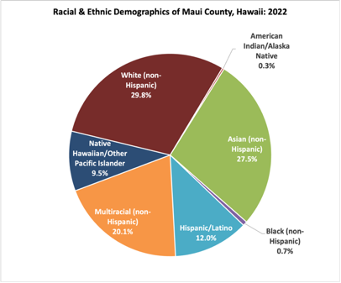
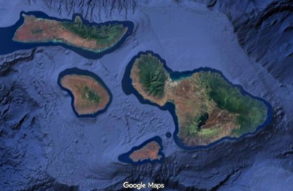
Maui County, Hawaii
Maui County covers over 1,100 square miles and four islands (only three are inhabited): Maui, Moloka’i, Lanai, and Kaho’olawe.
Total Population approx. 164,000 (County of Maui, n.d.) - Island of Maui: population 153,400 - Island of Moloka’i: population 7,400 - Island of Lanai: population 3,200
White, Asian, and Multiracial residents make up more than ¾ of population
Native Hawaiian are a minority population across the county as a whole - On Moloka’i, Native Hawaiian are the community majority with 65% of the island population
Unemployment rate 3.4%
Two official languages: English and Hawaiian
Median household income of $95,076
Internet access in 83.6% of households (Hawai’i Health Matters, 2024)
9.8% of residents live below the poverty level (U.S. Census Bureau, 2023)
13.8% of residents receive SNAP benefits
Figure 1. Pie chart of Maui County racial and ethnic demographics.
Graphic created by the author using Excel using County of Maui data. Source: McNeese, S. (2025) (Data derived from County of Maui, n.d.)
Moloka’i
Lanai
Maui
Kaho’olawe (uninhabited)
Figure 2. Maui County map. Screenshot of Maui County geography. Source: Google. (n.d.). Google Maps. https://www.google.com/maps
Notes:
Moloka’i Island also contains the county of Kalawao on its northern coast, encompassing only 12 sq mi with a population of 91 (Office of Hawaiian Affairs [OHA], n.d.). It has very few resources, no permanent healthcare facilities, and the residents are the responsibility of the State of Hawaii government.

Slide 4

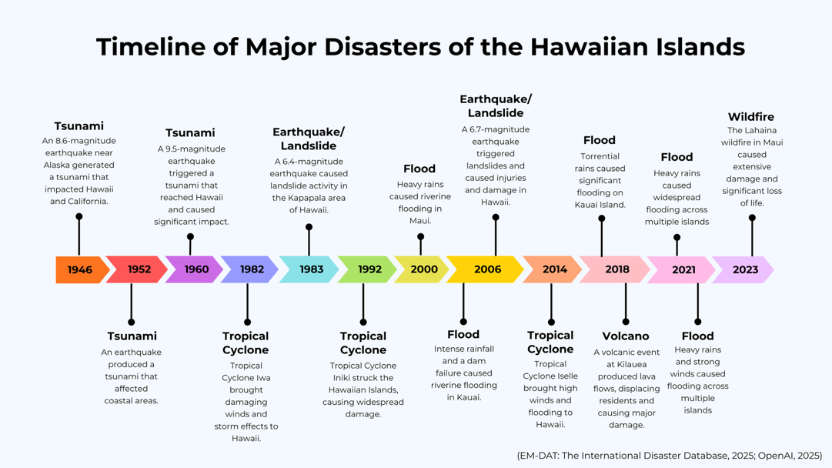
Historical Disasters of the Hawaiian Islands
Figure 3. Timeline of historical disasters affecting Hawaiʻi. Graphic created by the author using Canva. Source: McNeese, S. (2025).
Notes:
I noticed that EM-DAT did not include certain historical disasters, for example, when I was initially searching in my local area, there was no data on the 150-vehicle pileup in Fort Worth in February 2021, a mass-casualty disaster that strained local hospitals. Therefore, this list may not contain all disasters affecting Hawaii since 1900.
The Hawaiian Islands are particularly vulnerable to tsunamis, tropical cyclones, and flooding. Maui County is still actively recovering from its latest disaster, the Lahaina wildfires (Honolulu Civil Beat, 2025).
Because Maui County encompasses a large portion of the state of Hawaii, I searched data on the entire state. My rationale was that Maui County is in close proximity to the other islands and vulnerable to the same types of disasters.
Image created by S.McNeese, utilizing Canva.

Slide 5

Vulnerability Profile
Only four hospitals in the county with licensed acute care beds (Ye, 2025)
Significant portion of populated coastline falls within the tsunami evacuation zone (Tsunami Aware, 2025)
None of the four major hospitals are located within the tsunami zone
Island of Maui has three primary airports (State of Hawaii, n.d.-a)
Lanai and Moloka’i each have small regional airports
Many communities are rural and geographically isolated
Moloka’i Island has the highest social vulnerability (ATSDR, 2022)
Figure 4. Social Vulnerability Index map for Maui County, Hawaiʻi (2022). Reproduction of ATSDR SVI map. Source: Agency for Toxic Substances and Disease Registry. (2022). CDC/ATSDR Social Vulnerability Index 2022: Maui County, Hawaii. https://svi.cdc.gov/Documents/CountyMaps/2022/Hawaii/Hawaii2022_Maui%20County.pdf
Notes:
Only four hospitals in the county with licensed acute care beds (Ye, 2025)
- Of the four hospitals, only one (Maui Memorial) has a significant number of acute care beds. The rest all have between 9 and 15 each.
Significant portion of populated coastline falls within the tsunami evacuation zone (Tsunami Aware, 2025)
None of the four major hospitals are located within the tsunami zone
Island of Maui has three primary airports (State of Hawaii, n.d.-a). One is international, the other two are regional. - Kahului Airport is the main, international airport and is located well within the tsunami zone (Tsunami Aware, 2025)
Lanai and Moloka’i each have a small regional airport - Many residents on the outlying islands of Lanai and Moloka’i travel to Oahu for specialist visits (Lyte, 2023). The unreliability of the single airport/airline per island can cause missed appointments and contribute to poorer quality of health outcomes for residents of both islands.
When it comes to social determinants of health (SDOH), Moloka’i, and to a lesser extent Lanai, have the highest vulnerability of the three inhabited islands in Maui County. For this presentation, I will be focusing primarily on Moloka’i due to the large minority population of Native Hawaiian people. However, many of the SDOH disparities experienced by the people on Moloka’i are shared by those on Lanai, despite their different population mixes. We should not discount Lanai when discussing pre-disaster planning for Maui County. I would like to see further research focusing on residents of Lanai.

Slide 6

Vulnerability Profile: Moloka’i Island
Geographically isolated with single community airport and one ferry that runs 3x/day
Low wages combined with high cost of living contribute to food and housing insecurity (U.S. Census Bureau, 2023)
Number of households below the poverty line: 18%
33% of families receive SNAP benefits
Unemployment rate in August 2025 was 3.9% (State of Hawaii, n.d.-b)
Less-traditional residences make up 12% of housing (OHA, 2024)
Extremely limited access to local healthcare resources
Native Hawaiian are 65% of population; rely heavily on subsistence/farming as food sources (Akutagawa et al., 2016)
Traditional spearfishing has been practiced for centuries (Hansen et al., 2025)
Figure 5. Hawaiian man spearfishing in Hana, Maui, circa 1890.
Historical image from Wikimedia Commons. Source: Wikimedia Commons. (n.d.). Hawaiian man spear fishing, Hana, Maui, ca. 1890. https://commons.wikimedia.org/wiki/File:Hawaiian_man_spear_fishing,_Hana,_Maui,_ca._1890.jpg
Notes:
Geographically isolated with single community airport and one ferry that runs 3x/day
Low wages combined with high cost of living contribute to food and housing insecurity (U.S. Census Bureau, 2023)
Unemployment rate in August 2025 was 3.9% State of Hawaii, n.d.-b) The Maui Economic Labor Board (n.d.) reports that this is lower than usual, and that the island’s unemployment rate has improved since the Covid-19 Pandemic in 2020.
Number of households below the poverty line: 18% - nearly double the rate of Maui County as a whole
33% of residents receive SNAP benefits
Less-traditional residences (mobile homes, boats, RVs, etc.) make up 12% of housing (OHA, 2024)
Limited access to healthcare, shortage of healthcare providers and only one community hospital - residents often travel to Oahu for healthcare; barriers exist due to unreliable flights at island’s single airport - according to the Office of Hawaiian Affairs (2024), the airport on Moloka’i often cancels flights last minute and is highly unreliable - only 15 beds on the island that are classified as acute care, and there are no other licensed beds on the island that can be converted.
Native Hawaiian are 65% of population; rely heavily on subsistence/farming as food sources (Akutagawa et al., 2016) - According to a 2016 study by Akutagawa et al., some families rely on subsistence and farming for up to 40% of their food source.
Traditional spearfishing has been practiced for centuries by Native Hawaiians (Hansen et al., 2025) - 43% of indigenous population on Moloka’i participate in spearfishing - contributes to food security for Native Hawaiian community - could be negatively impacted in the event of a tsunami or hurricane, disrupting food sources and further escalating the vulnerability of population
Image retrieved November 16, 2025 https://commons.wikimedia.org/wiki/File:Hawaiian_man_spear_fishing,_Hana,_Maui,_ca._1890.jpg

Slide 7

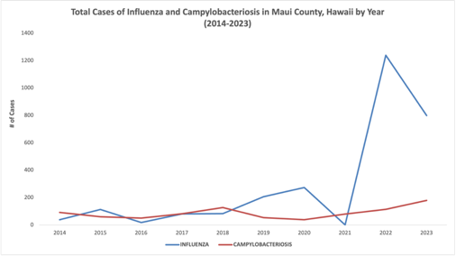
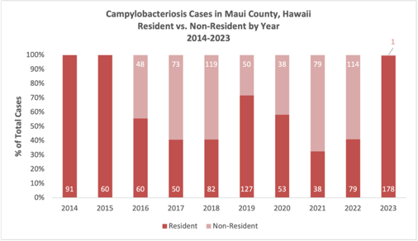
Current Health Trends Relevant to Disaster Preparation
Influenza - Respiratory virus, spread by droplets (CDC, 2024b) - Vaccination is first and best line of defense - Mask wearing may be helpful in a disaster scenario - Outbreaks common after destructive tsunamis (Mavrouli et al., 2021)
Campylobacteriosis - bacterial diarrheal illness (CDC, 2024a) - actual cases may be higher than reported - commonly spread through contaminated poultry - Increase in antibiotic-resistant strains past 20 years - can be a significant problem following a disaster (Saingam et al., 2021)
Figure 6. Maui County influenza and campylobacteriosis cases (2014–2023). Data visualization created by the author in Excel using SHDH data.
Source: McNeese, S. (2025). (Data derived from State of Hawaii Department of Health, 2025c)
Figure 7. Campylobacteriosis cases in Maui County (2014-2023.
Data visualization created by the author in Excel using SHDH data. Source: McNeese, S. (2025). (Data derived from State of Hawaii Department of Health, 2025c)
Notes:
Because Hawaii no longer participates in COVID-NET, it was challenging to obtain data on COVID-19 rates in Maui County or the state of Hawaii. The State of Hawaii COVID dashboard is also no longer being updated (State of Hawaii Department of Health [SHDH], 2025a). Therefore, I am only including data about influenza and campylobacter infections.
Monkeypox has not been widely reported in Hawaii, with zero cases in Maui County this year; I decided not to include it in this project (SHDH, 2025c).
In Maui County, respiratory disease such as influenza, as well as foodborne/waterborne disease such as Campylobacter, could present a threat to public health following a disaster.
Influenza: significant spike in recent years (State of Hawaii Department of Health, n.d.) - Respiratory virus, spread through droplets (CDC, 2024b) - Vaccination is first and best line of defense - Mask wearing may be helpful in a disaster scenario - Outbreaks common after destructive tsunamis (Mavrouli et al., 2021)
Campylobacteriosis: trending upward, with a steady rate of cases each year (State of Hawaii Department of Health, n.d.) - bacterial diarrheal illness (CDC, 2024a) - actual cases may be higher than reported - most commonly spread through contaminated/undercooked poultry - Increase in antibiotic-resistant strains in past 20 years - can be a significant problem in aftermath of a disaster (Saingam et al., 2021) - Maui County has high numbers of feral chickens (Perry, 2024). Following a disaster, if food supplies run short, people may capture and eat these. Crowded and unsanitary conditions may provide perfect conditions for campylobacter to spread.

Slide 8

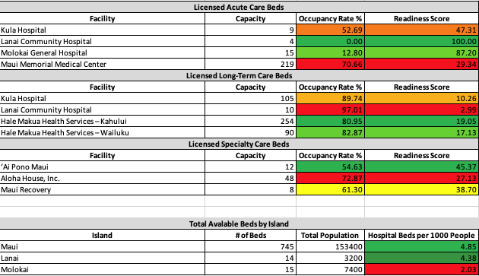
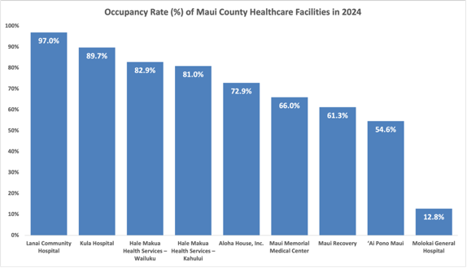
Healthcare Capacity
Only four hospitals in the county with licensed acute care beds (Ye, 2025)
Of these, Maui Memorial contains the most at 219 acute care beds
Moloka’i has only 2.02 beds per 1000 capita
LTC and Specialty care beds may potentially be converted
There are also three ambulatory surgery centers in the county with potential resources (State of Hawaii Department of Health, 2025b)
Figure 8. Licensed care beds in Maui County hospitals (2024). Data visualization created by the author in Excel using SHPDA data. Source: McNeese, S. (2025). (Data derived from Ye, 2025.)
Figure 9. Occupancy rates in Maui County hospitals (2024). Data visualization created by the author in Excel using SHPDA data. Source: McNeese, S. (2025). (Data derived from Ye, 2025.)
Notes:
Only four hospitals in the county with licensed acute care beds (Ye, 2025)
Of these, Maui Memorial contains the most at 219 acute care beds
The remaining three healthcare centers have 28 acute beds between them
Maui County has additional beds in the form of long-term care (LTC) and specialty care (detox and disorder rehabilitation)
Moloka’i has only 2.02 beds per 1000 capita, less than the national average of 2.35 (Taylor, 2024).
LTC and Specialty care beds may potentially be converted
There are also three ambulatory surgery centers in the county with potential resources including supplies and ventilators/anesthesia machines (State of Hawaii Department of Health, 2025b)

Slide 9

Risk Identification
Geographic & Environmental Risks
High-SVI areas (especially Molokaʻi) with limited transportation and higher isolation risk
Elevated potential for wildfires (Sowby & Porter, 2024)
Coastal communities and critical infrastructure within tsunami evacuation zones (Tsunami Aware, 2025)
Rural regions with limited access roads
Healthcare System Risks
Limited acute bed capacity on Molokaʻi (Ye, 2025)
Potential disruption to inter-island transport for patient transfers (OHA, 2024)
Reliance on a small number of hospitals for countywide surge events (Ye, 2025)
Technology/Communication Risks
Households without internet/smartphone access (Hawai’i Health Matters, 2024)
Population Health Risks
Elderly, low-income, and Native Hawaiian populations with higher vulnerability (County of Maui, n.d.)
Exacerbations of respiratory, cardiac, and GI health issues following a disaster (Stimpson et al. 2025)
Notes:
Geographic & Environmental Risks
High-SVI areas (especially Molokaʻi) with limited transportation and higher isolation risk
Elevated potential for wildfires to devastate both communities and health outcomes (Sowby & Porter, 2024)
Coastal communities and critical infrastructure (international airport) within tsunami evacuation zones (Tsunami Aware, 2025)
Rural regions where delayed access is likely during a disaster
Healthcare System Risks
Limited acute bed capacity on Molokaʻi (Ye, 2025) - risk of rapid facility overload
Potential disruption to inter-island transport for patient transfers (OHA, 2024)
Reliance on a small number of hospitals for countywide surge events (Ye, 2025)
Technology/Communication Risks
Significant number of households without internet access. The number of households in the county with internet dropped over 12% from 2023 to 2024, possibly as a result of the Lahaina wildfires disaster (Hawai’i Health Matters, 2024). As of December 2024, only 83.6% of adults had internet access. This number may have improved as recovery from the wildfires progresses. Can reassess when 2025 data is available.
Smartphone access is better, still a significant number without in isolated communities on Moloka’i
Population Health Risks
Elderly adults, low-income communities, and Native Hawaiian populations with higher vulnerability (County of Maui, n.d.)
Exacerbations of respiratory, cardiac, and gastrointestinal health issues following a disaster (Stimpson et al. 2025)

Slide 10
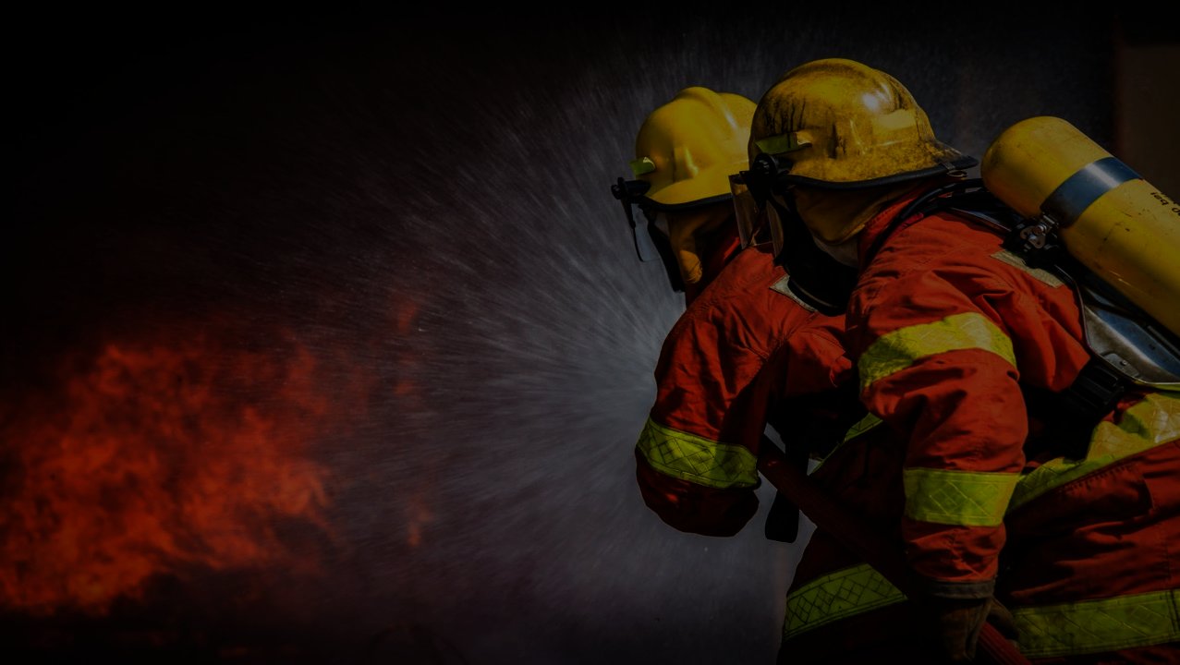
Risk Identification
Disasters and extreme weather events are linked to higher rates of PTSD, depression, and anxiety (Stimpson et al. 2025).
Heatwaves, droughts, and wildfires are tied to increases in cardiovascular, respiratory, and metabolic problems.
Only a small portion of disaster-health research looks at how SDOH such as poverty, rural location, and ethnicity overlap
Research focusing on the island of Moloka’i, rather than Maui County as a whole, is sparse.
Notes:
Disasters and extreme weather events are linked to higher rates of post-traumatic stress, depression, and anxiety, especially for people who already face social or economic disadvantages (Stimpson et al. 2025).
Heatwaves, droughts, and wildfires are tied to increases in cardiovascular, respiratory, and metabolic problems, particularly for older adults and workers who spend long hours outdoors.
Only a small portion of disaster-health research looks at how SDOH such as poverty, rural location, and ethnicity overlap, which means we still have limited understanding of how these combined challenges affect vulnerable communities.
Research focusing on the island of Moloka’i, rather than Maui County as a whole, is sparse. A search of Hawaiʻi Health Data Warehouse showed that Moloka’i is not well represented in its survey data (Hawaiʻi Health Data Warehouse, n.d.). Given the island’s digital access gaps, geographic isolation, and the limited research on SDOH in Molokai, there is a need for additional study and improved access to federal and state grant funding to study and strengthen infrastructure, communication systems, healthcare capacity, and disaster mitigation.

Slide 11

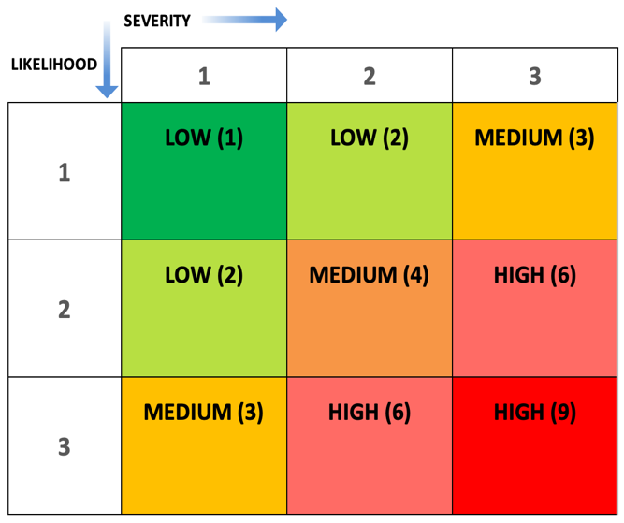
Risk Matrix
R6
R4
R7
R1. Isolation of Molokaʻi during a disaster
R2. Hospital surge with limited acute beds
R3. Broadband or communication outage
R4. Tsunami impact on coastal communities
R5. Post-disaster influenza increase
R6. Campylobacter outbreaks after disaster
R7. Airport disruption affecting medical evacuations
R8. Wildfire event overwhelming emergency response
R5
R3
R2
R1
R8
Figure 10. Risk matrix of prioritized hazards for Maui County. Matrix created by the author to rank disaster risks. Source: McNeese, S. (2025).
Notes:
R1. Isolation of Molokaʻi during a disaster – Single airport, ferry limitations, and rural geography make Molokaʻi highly vulnerable to becoming cut off from medical, supply, and evacuation routes. Only 77.6 percent of households in Moloka’i have access to a smartphone and around 73% have internet access, making a significant portion of the island’s population vulnerable to a communication breakdown (Hawai’i Health Matters, 2024).
R2. Hospital surge with limited acute beds – Maui County has only four hospitals and 247 acute beds, making the system susceptible to overload during large-scale emergencies (Ye, 2025).
R3. Broadband or communication outage – With only 83.6% internet access and many rural communities, communication disruption during disasters may delay warnings and response (Hawai’i Health Matters, 2024). When the power goes out, grounded internet access will be lost, however cellphones may still work. The percentage of households in Maui County with at least one smartphone is around 89% (Hawai’i Health Matters, 2024).
R4. Tsunami impact on coastal communities – Large portions of Maui’s populated coastline, including the main international airport, fall within the tsunami evacuation zone (Tsunami Aware, 2025).
R5. Post-disaster influenza increase – Influenza cases have surged in recent years and crowding after disasters increases respiratory transmission risk (Mavrouli et al., 2021).
R6. Campylobacter outbreaks after disaster – Maui has abundant feral chickens (Perry, 2024). Undercooked, contaminated poultry is the most common mode of transmission (CDC, 2024a). The county also reports a stable yet significant number Campylobacter cases per year (State of Hawaii Department of Health, n.d.). Conditions after disasters can heighten foodborne spread of bacterial diseases (Saingam, 2021).
R7. Airport disruption affecting medical evacuations – Maui depends on three airports and Molokaʻi/Lānaʻi each have one small regional airport, making air travel interruptions a significant barrier to care.
R8. Wildfire event overwhelming emergency response - Maui County faces a growing wildfire risk, especially in areas with dry vegetation, limited water supplies, and few evacuation routes (Sowby & Porter, 2024). Over 50% of the population of Maui lives within an area at risk for wildfires (County of Maui, 2025). A large event could easily strain emergency response resources.

Slide 12

Disaster Mitigation
Strengthen Healthcare Readiness
Pre-position medical supplies and emergency kits in high-risk and remote areas
Deploy mobile healthcare units to extend reach when roads, airports, or ferries are disrupted
Identify potential surge spaces (e.g., LTC/Specialty beds that can be temporarily converted)
Boost Community Resilience
Build reliable communication channels: SMS alerts, radio broadcasts, and partnerships with community leaders
Provide targeted outreach to high-SVI populations on preparedness, safe food/water practices, and evacuation procedures
Coordinate with EMS, public health, and local hospitals for unified emergency operations
Increase public campaigns for influenza vaccination, before the next disaster occurs

Slide 13

Pre-Disaster Action Plan
Priority Focus: Wildfire, Tsunami, Hospital Surge, Molokaʻi Isolation
Vulnerability Assessment
High-SVI communities on Molokaʻi, East Maui, and rural areas
Limited acute care beds; transport-dependent islands; communication gaps
Identify at-risk populations
Risk Mitigation Strategies
Pre-position supplies (PPE, medications, IV fluids)
Identify and prepare surge beds and LTC-to-acute conversion spaces
Develop mobile clinic model for Molokaʻi in event of isolating event
Strengthen food/water safety and pre-season flu outreach
Emergency Response Coordination
Coordinate with stakeholders
Integrate alternate-care sites and evacuation/shelter partners into planning
Communication Plan
Redundant alerts: explore SMS/radio/in-person outreach
Partner with Molokaʻi leaders for culturally aligned messaging
Target high-SVI communities with plain-language updates
Notes:
Here I summarized my health-focused pre-disaster actions and aligned them with the 2025 Maui County Hazard Mitigation Plan (County of Maui, 2025). Due to its length, I utilized generative AI to help me extract information from the plan for this portion of the assignment (OpenAI, 2025). The MEMA plan contains enormous amounts of information and will be an invaluable resource for developing an effective pre-disaster plan.
Vulnerability Assessment
High-SVI communities on Molokaʻi, East Maui, and rural areas
Limited acute care beds; transport-dependent islands; communication gaps
Populations at risk: older adults, children under the age of five, chronic disease, low-income, Native Hawaiian communities
Risk Mitigation Strategies
Pre-position supplies (PPE, medications, IV fluids) in Molokaʻi and other high-SVI zones like Lanai and eastern Maui
Identify and prepare surge beds and LTC-to-acute conversion spaces
Develop mobile clinic model for Molokaʻi during isolation
Strengthen food/water safety and pre-season flu outreach
Emergency Response Coordination
Coordinate with Maui Emergency Management Agency, DOH, EMS, and Molokaʻi community partners
Align actions with Maui County HMP goals
Integrate alternate-care sites and evacuation/shelter partners into planning
Communication Plan
Redundant alerts: explore SMS/radio/in-person outreach
Partner with Molokaʻi leaders for culturally aligned messaging that will be effectively transmitted to Native Hawaiian community
Target high-SVI communities with plain-language updates on routes, shelters, and clinics

Slide 14
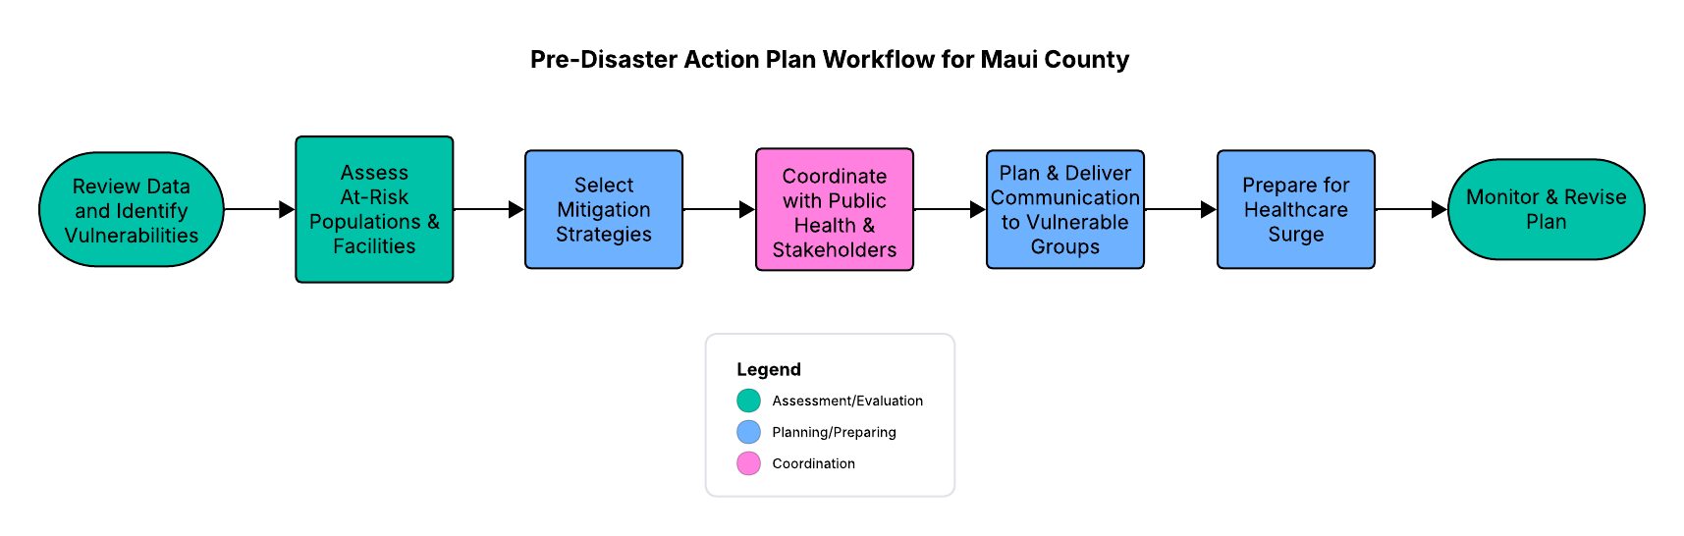
Pre-Disaster Flowchart
Figure 11. Pre-disaster action plan workflow. Flowchart created by the author using LucidChart. Source: McNeese, S. (2025).

Slide 15

Summary
Maui County faces a unique combination of geographic isolation, uneven healthcare capacity, and high social vulnerability, especially on Molokaʻi, which all elevate risk during major disasters. This assessment brought those gaps to light by identifying where resources and data are limited, which populations are most at risk, and how hazards like wildfires, tsunamis, and disease outbreaks intersect with these vulnerabilities. The Pre-Disaster Action Plan strengthens community readiness by targeting mitigation strategies, coordinated communication, and surge planning that supports a more resilient and equitable response. While this project provides a solid foundation, there is far more that could be explored with additional time, particularly deeper Molokaʻi-specific research expanding to include the tiny county of Kalawao, which shares the island. Expanding this work could one day grow into a meaningful doctoral project.

Slide 16

Generative AI Attestation
I attest that I used a generative AI tool in accordance with course guidelines and assignment-specific permissions. I used ChatGPT (OpenAI, 2025) on November 13, 2025 and November 19, 2025, for the purpose of generating one-sentence summaries for my disaster timeline, assisting with data set analysis, translating PDF data into Excel tables, and comparing my assignment with the rubric. The prompt(s) used included: “Help me generate a one-sentence summary for each disaster,” “Convert this campylobacteriosis row into an excel table with two rows labeled Resident and Non-Resident, with the years along the top,” and “Help me extract information from this hazard mitigation plan to create a Pre-Disaster Action Plan specifically for Maui County.”
All AI-generated content was critically reviewed, edited, and appropriately integrated with my own academic and clinical reasoning.

Slide 17

References
Agency for Toxic Substances and Disease Registry. (2022). CDC/ATSDR Social vulnerability index 2022: Maui County, Hawaii. Geospatial Research, Analysis, and Services Program. https://svi.cdc.gov/Documents/CountyMaps/2022/Hawaii/Hawaii2022_Maui%20County.pdf
County of Maui. (n.d.). County profile. https://www.mauicounty.gov/DocumentCenter/View/155215/010-07-County-Profile
County of Maui. (2025, August). County of Maui 2025 hazard mitigation plan [Hazard mitigation plan]. Maui Emergency Management Agency.https://www.mauicounty.gov/DocumentCenter/View/155657/2025-County-of-Maui-Hazard-Mitigation-Plan
EM-DAT: The International Disaster Database. (2025, November 7). Natural and technological disasters of the Americas from 1900 to 2025 (EM-DAT, CRED/UCLouvain, Brussels, Belgium; Version 2025-11-07) [Data set]. Centre for Research on the Epidemiology of Disasters. https://public.emdat.be/data
Google. (n.d.). Google Maps. https://www.google.com/maps
Hansen, L., Wu, Y. Y., Sentell, T. L., Thompson, M., St John, T. L., Schmid, S., & Pirkle, C. M. (2025). Spearfishing and public health promotion: A cross-sectional analysis of the Hawai'i Behavioral Risk Factor Surveillance System survey. PloS One, 20(3), e0319169. https://doi.org/10.1371/journal.pone.0319169
Hawaiʻi Health Data Warehouse. (n.d.). Build your own report. Department of Public Health Sciences. https://hhdw.org/data-sources/
Hawai’i Health Matters. (2024, December). Households with a smartphone. Conduent Healthy Communities Institute. https://www.hawaiihealthmatters.org/?module=indicators&controller=index&action=view&comparisonId=&indicatorId=10515&localeId=12241
Honolulu Civil Beat. (2025, August 7). See a bird’s-eye view of Lahaina’s fire recovery. https://www.civilbeat.org/2025/08/the-view-from-above-how-far-weve-come-since-the-maui-fires-2/
Lyte, B.(2023, May 7). With one airline left, Molokai and Lanai residents struggle to access medical care. Honolulu Civil Beat. https://www.civilbeat.org/2023/05/with-one-airline-left-molokai-and-lanai-residents-struggle-to-access-medical-care
Office of Hawaiian Affairs. (2024). Island community report: Moloka’i. Office of Research and Evaluation. https://www.oha.org/wp-content/uploads/2024-Molokai-Island-Community-Report.pdf
Office of Hawaiian Affairs. (n.d.). Kalawao County. https://www.oha.org/wp-content/uploads/RPT_Kalawao-County.pdf
OpenAI. (2025). ChatGPT (GPT-5, November 13 version) [Large language model]. https://chatgpt.com/share/6916bff2-9ac0-800b-bb65-64927b43c4a2
Maui Economic Development Board. (n.d.). Molokai. https://www.medb.org/maui-sectors/molokai/
Mavrouli, M., Mavroulis, S., Lekkas, E., & Tsakris, A. (2021). Respiratory infections following earthquake-induced tsunamis: Transmission risk factors and lessons learned for disaster risk management. International Journal of Environmental Research and Public Health, 18(9), 4952. https://doi.org/10.3390/ijerph18094952
Molokai Community Health Center. (n.d.). Overview of organization [Image]. https://molokaichc.org/wp-content/uploads/2015/11/entrance-top.jpg
Perry, B. (2024, July 2). Governor signs bill to help tame flocks of feral chickens in Hawaiʻi. MauiNow. https://mauinow.com/2024/07/02/governor-signs-bill-to-help-tame-flocks-of-feral-chickens-in-hawai%CA%BBi/
Notes:
All slide background images were obtained from PowerPoint stock images.

Slide 18
References
Saingam, P., Li, B., Sung, S., & Yan, T. (2021). Immediate impact of Hurricane Lane on microbiological quality of coastal water in Hilo Bay, Hawaii. Environmental Science & Technology, 55(5), 2960–2967. https://doi.org/10.1021/acs.est.0c07082
Sowby, R. B., & Porter, B. W. (2024). Water supply and firefighting: Early lessons from the 2023 Maui fires. Water, 16(4), 600. https://doi.org/10.3390/w16040600
State of Hawaii. (2025, September). Census data highlights. Department of Business, Economic Development & Tourism. https://files.hawaii.gov/dbedt/census/acs/acs2024/1yr/acs2024_1-yr_highlights_2025-09-11.pdf
State of Hawaii. (n.d.-a). Hawaii airports system. Department of Transportation. https://airports.hawaii.gov/
State of Hawaii. (n.d.-b). Unemployment statistics. Department of Business, Economic Development & Tourism. https://dbedt.hawaii.gov/economic/unemployment-statistics/
State of Hawaii Department of Health. (2025a, June 12). New case counts. Disease Outbreak Control Division. https://health.hawaii.gov/coronavirusdisease2019/tableau_dashboard/new-case-counts/
State of Hawaii Department of Health. (2025b, July 23). Ambulatory surgery centers: Freestanding surgical outpatient facilities. Office of Health Care Assurance. https://health.hawaii.gov/ohca/medicare-facilities/ambulatory-surgery-centers-freestanding-outpatient-surgical-facilities/
State of Hawaii Department of Health. (2025c, August 7). Mpox (Monkeypox). Disease Outbreak Control Division. https://health.hawaii.gov/docd/disease_listing/mpox/
State of Hawaii Department of Health. (n.d.). 10-year summary of reported cases of notifiable diseases, Maui County , Hawai`i, 2014–2023. Disease Outbreak Control Division. https://health.hawaii.gov/docd/files/2025/01/Disease-Summary-Table-2014_2023_Maui.pdf
Stimpson, J. P., Rashed, A. L., Pandya, J., Baudot, E. C., Whitfill, J., & Ortega, A. N. (2025). Health equity in the wake of disasters and extreme weather: evidence from an umbrella review. Health Affairs Scholar, 3(11), qxaf207. https://doi.org/10.1093/haschl/qxaf207
Taylor, M.. (2024, Feb 21). States ranked by hospital beds per 1,000 population. Beckers Hospital Review. https://www.beckershospitalreview.com/rankings-and-ratings/states-ranked-by-hospital-beds-per-1-000-population-4/
Tsunami Aware. (2025). Hawai’i. https://tsunami.coast.noaa.gov/
USAFacts. (2022, July). Our changing population: Maui County, Hawaii. https://usafacts.org/data/topics/people-society/population-and-demographics/our-changing-population/state/hawaii/county/maui-county/?endDate=2022-01-01&startDate=2010-01-01
U.S. Census Bureau. (2023). American Community Survey 5-year estimates. Census Reporter. https://censusreporter.org/search/?q=molokai
U.S. Centers for Disease Control and Prevention. (2024a, May 10). About campylobacter infection. https://www.cdc.gov/campylobacter/about/
U.S. Centers for Disease Control and Prevention. (2024b, August 13). About influenza. https://www.cdc.gov/flu/about/
Wikiedia Commons. (n.d.). Hawaiian man spear fishing in Hana, Maui, ca. 1890 [Image]. https://commons.wikimedia.org/wiki/File:Hawaiian_man_spear_fishing,_Hana,_Maui,_ca._1890.jpg
Ye, D. (2025, September 3). Healthcare utilization report: Hawaii 2024. State Health Planning and Development Agency. https://health.hawaii.gov/shpda/files/2025/09/2024-Hawaii-Healthcare-Utilization-Report-20250903.pdf

