Slide 1

Wellness Watch
Enterprise Data Warehouse (EDW)
Stephanie McNeese & Belinda Merkel-Coleman
Texas Tech University Health Sciences Center
NURS 5332 – Informatics II
Dr. Steph Hoelscher
October 20, 2025

Slide 2
Overview
Source Systems Map
Extract, Transform, Load (ETL) Process
Data Model (Star Schema)
Data Governance & Quality
EDW Pipeline Design Visual
Dashboard Mockup
Summary of Operational Definitions
Participation Statement
Generative AI Attestation
References

Slide 3
Source Systems Map
Wellness Watch EDW
Source System | Data Type | Example Data | Refresh Frequency | Owner/Governing Body
Health Clinic EHRs | Structured & Unstructured | Vital Signs, Patient Demographics, BMIs, Provider Notes, Images | Daily or real-time | Healthcare System, Providers/ONC, CMS
Community Programs Registry | Structured & Unstructured | Community Health Program Attendance, County of Program, Completion Status | Monthly | Public Health Department
Pharmacy Data | Structured | Adherence Rates, Medications, Conditions | Weekly | Pharmacy Network/TSBP
Public Health Data | Structured | Population, Obesity Rate, Flu Vaccination Rates | Quarterly | Texas DSHS
SDOH Data | Structured | Incomes, Education, Rurality | Annually | U.S. Census Bureau
Notes:
Integrates data from five sources: Clinic EHRs, Community Programs Data, Pharmacy, Public Health Data, and Social Determinants of Health (SDOH) Data
Sources vary between structured and unstructured formats.
Refresh frequencies vary from daily to annually.
While providers and healthcare systems legally own the data with an EHR, the Office of the National Coordinator for Health Information Technology (ONC) and Centers for Medicare & Medicaid Services (CMS) are the primary governing bodies for EHRs in the United States, setting standards that all EHRs must meet to maintain interoperability and meaningful use (CMS, 2024).
Likewise, pharmacy data is owned by the pharmacy network or company, but is regulated by the Texas State Board of Pharmacy (Texas State Board of Phamacy [TSBP], n.d.).
The American Community Survey (ACS) releases annual updates of SDOH data for Texas counties (State Health Access Data Assistance Center [SHADAC], 2025).
Insights and ideas for this slide were assisted by generative AI (OpenAI, 2025).

Slide 4

Extract, Transform, Load (ETL) Process Overview
Extract (Getting the Data)
EHR Data: Pulled directly from the EHR platform report system
Pharmacy Data: Obtaining data from pharmacy claims, directly from pharmacy, or from TSBP prescription drug monitoring database
Community Programs: Spreadsheet data provided by county health departments
Public Health and SDOH Data: Downloaded from public health databases or state health report
(Stair & Reynolds, 2018, Chapter 3)
Notes:
Data is pulled from each source system in a way that makes sense for how often it changes. Data can be extracted from multiple systems, including EHR encounter records, pharmacy claims data, community program spreadsheets, and publicly available SDOH datasets. In practice, this could include automated extracts from EHR systems, secure file transfers for claims data, and manual uploads from program participants, such as pharmacies and public health departments.
The goal here is to collect all the data in one place.

Slide 5
Extract, Transform, Load (ETL) Process Overview
Transform (Cleaning and Preparing the Data)
Fixing missing or inconsistent information (e.g., standardizing gender codes or date formats)
Ensuring measurements are in the same units (e.g., imperial vs. metric system)
Matching up data by location or time (e.g., connecting ZIP codes to counties)
Eliminating duplicate entries and obvious errors.
(Stair & Reynolds, 2018, Chapter 3)
Notes:
This is where the data gets cleaned up and made consistent so it can be compared and analyzed.
The goal here is to make the data neat, accurate, and compatible across all sources.

Slide 6
Extract, Transform, Load (ETL) Process Overview
Load (Putting the Data into the Warehouse)
All the key measures go into one main Fact Table (the central dataset).
Supporting information like counties, programs, or years are stored in Dimension Tables.
The database is organized so that it is fast and easy to run reports and build dashboards.
(Stair & Reynolds, 2018, Chapter 3)
Notes:
The clean data is loaded into the Enterprise Data Warehouse (EDW) so that it can be analyzed.
The goal here is to store the data in a way that supports easy reporting and trend analysis.

Slide 7

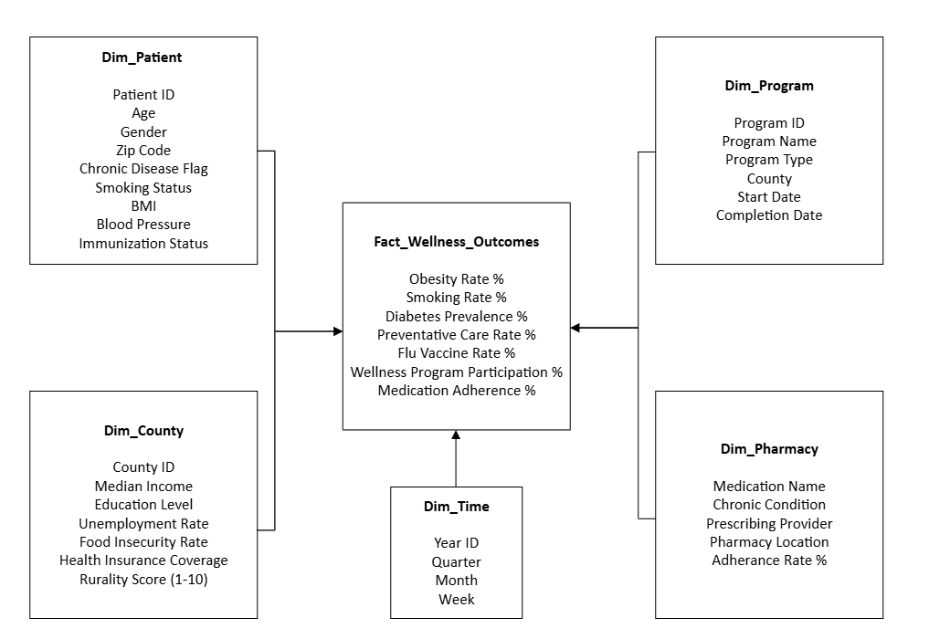
Data Model (Star Schema)
Notes:
This illustration was created by B. Merkel-Coleman, utilizing Visio.

Slide 8
Data Governance & Quality
# | KPI | Data Stewards | Ensure Accuracy/Completeness/Timeliness
1 | Increase Wellness Program participation by 10% by January 2026. | Community Health Program Coordinator | Accuracy: Validate program rosters monthly Completeness: Perform quarterly audits Timeliness: Data submitted monthly
2 | Increase Medication Adherence by 20% by June 2026. | Pharmacy Informatics Analyst | Accuracy: Validate data and remove anomalies and obvious errors Completeness: Require all network pharmacies to submit monthly reports Timeliness: Monthly reporting schedule
3 | Increase Flu Vaccine Coverage by 25% by December 2025. | Public Health Informatics Nurse | Accuracy: Reconcile clinic logs with state immunization registry data Completeness: Require all affiliated clinics to submit vaccination records. Timeliness: Data uploaded to the dashboard within two weeks after each vaccination campaign period
4 | Increase Preventative Visit Rates by 10% by March 2026. | Clinical Informatics Nurse | Accuracy: Use EHR to flag eligible preventive visit codes and conduct chart audits on 25% of charts monthly Completeness: Require providers to review and close incomplete encounters Timeliness: Preventive care data updated monthly
5 | Increase Healthcare Coverage Rate to at least 90% average across all five counties by June 2026. | U.S. Census Bureau | Accuracy: Follow U.S. Census Bureau’s established statistical quality standards for demographic and socioeconomic data Completeness: Data collected through mandatory federal surveys Timeliness: Updated annually through the ACS
Notes:
KPI #1
Accuracy: Validate program rosters against registration logs and attendance sheets monthly.
Completeness: Perform quarterly audits to ensure all community events are logged.
Timeliness: Program participation data submitted monthly and refreshed on the dashboard every quarter.
KPI #2
Accuracy: Validate refill data from multiple pharmacy systems using NDC codes and patient IDs. Remove anomalies (e.g., duplicate refill logs or missing dates).
Completeness: Require all network pharmacies to submit monthly data reports. Monitor adherence metrics by medication name and chronic condition categories.
Timeliness: Monthly reporting schedule.
KPI #3
Accuracy: Match vaccine administration data with patient identifiers to prevent double counts. Reconcile clinic logs with state immunization registry data.
Completeness: Require all affiliated clinics to submit vaccination records, including mobile health events. Monitor missing records per site each quarter.
Timeliness: Data uploaded to the dashboard within two weeks after each vaccination campaign period.
KPI #4
Accuracy: Use EHR to flag eligible preventive visit codes (e.g., annual wellness visits). Random chart audits quarterly to confirm visit documentation accuracy.
Completeness: Require provider sites to review and close incomplete encounters.
Timeliness: Preventive care data updated monthly from the EHR system; dashboard refreshed each quarter.
KPI #5
Accuracy: Follow U.S. Census Bureau’s established statistical quality standards for demographic and socioeconomic data
Completeness: Data are collected nationwide through mandatory federal surveys such as the American Community Survey (ACS), capturing full geographic coverage across all U.S. counties
Timeliness: Updated annually through the American Community Survey with new datasets incorporated into the dashboard within 30 days of release
Insights and ideas for this slide were assisted by generative AI (OpenAI, 2025).

Slide 9
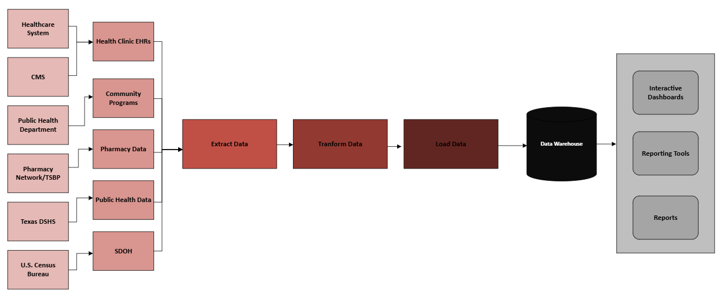
EDW Pipeline Design Visual
Notes:
This illustration was created by B. Merkel-Coleman, utilizing Visio.

Slide 10
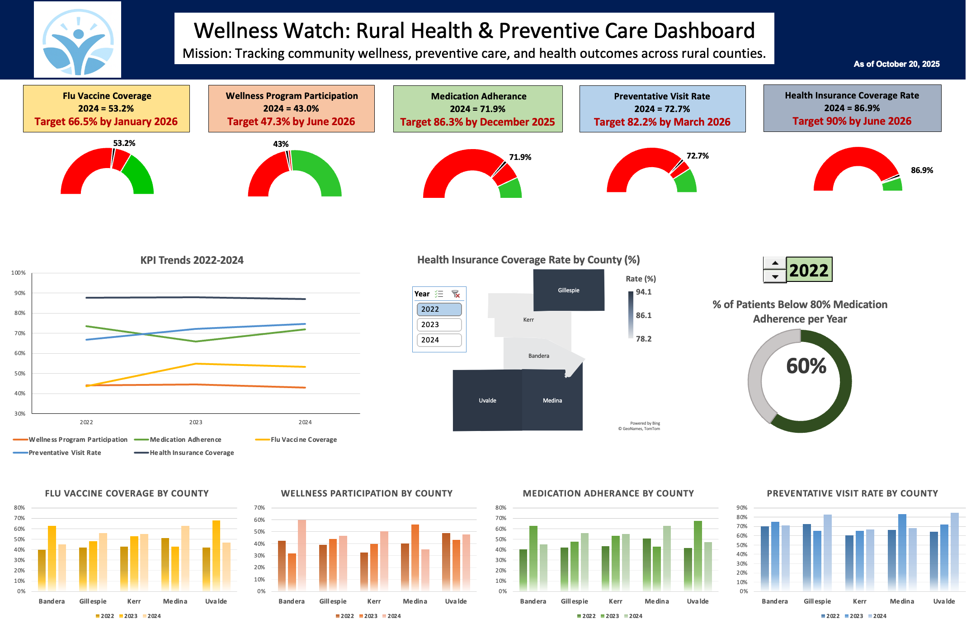
Dashboard Wireframe Mockup
Notes:
The Wellness Watch dashboard demonstrates how real data sources like EHRs, pharmacy claims, and public health records can support public health efforts. It uses evidence from actual health data, such as participation rates, medication adherence, and vaccination coverage, to track progress and guide decisions. The project explains how the ETL process and data model help clean, standardize, and combine this information for analysis. In practice, the dashboard could use reliable data to show how information can drive improvements in community health.
Our dashboard was generated utilizing synthetic data (OpenAI, 2025). Because the data is computer-generated, it contained very few actual insights or trends due to its random nature. Our mockup could change if actual data were sourced. Generative AI was also used to design the brand logo.

Slide 11
Summary of Operational Definitions
Key Performance Indicators | Definition | Data Source | Calculation Details
Increase Wellness Program participation by 10% by January 2026. | Measures percentage of eligible participants attending wellness programs | Community_Programs (Program_Name, Attendance_Rate(%), Completion_Status) | Numerator: Total participants who attended at least one session Denominator: Total eligible participants per program Target: +10% by Jan 2026
Increase Medication Adherence by 20% by June 2026. | Percentage of patients maintaining ≥80% adherence to prescribed medication | Pharmacy_Data (Adherence_Rate(%), Medication_Name, Chronic_Condition) | Numerator: Patients with adherence ≥80% Denominator: All patients with chronic medication Target: +20% by Jun 2026
Increase Flu Vaccine Coverage by 25% by December 2025. | Proportion of population receiving flu vaccine within a year | EHR_Data (Immunization_Status), Public_Health_Data (Flu_Vaccine_Coverage(%)) | Numerator: Individuals with flu vaccine recorded Denominator: Total eligible population Target: +25% by Dec 2025
Increase Preventative Visit Rates by 10% by March 2026. | Percentage of population completing recommended preventive care visits. | EHR_Data(Preventive_Visit_Date), Public_Health_Data (Preventive_Visit_Rate[%]) | Numerator: Patients with a preventive visit within last 12 months Denominator: Total active patients Target: +10% by March 2026
Increase Healthcare Coverage Rate to at least 90% average across all five counties by June 2026. | Percentage of population with active health insurance coverage. | SDOH_Data (Preventive_Visit_Rate[%]) | Numerator: Individuals with active health insurance coverage Denominator: Total population Target: 90% average or greater across all counties by June 2026

Slide 12
Statement of Participation
We, Stephanie McNeese and Belinda Merkel-Coleman, collaborated equally on this assignment. We utilized email to pass the documents back and forth, each working on a portion before passing it to the other. In this way we were able to equally contribute to the work and timely completion of the assignment.
Stephanie McNeese completed the geomap, KPI trends, and banner aspects of the dashboard. Belinda Merkel-Coleman completed the speed gauges and donut chart with year selection aspects of the dashboard.
We both worked equally and take responsibility for the PowerPoint presentation, operational definitions, bar graphs, and layout of the dashboard.

Slide 13
Generative AI Attestation
We attest that we used a generative AI tool in accordance with course guidelines and assignment-specific permissions. Stephanie used ChatGPT (OpenAI, 2025) on October 12, 2025, for the purpose of creating a hypothetical data set and suggesting an outline for completing the assignment. The prompt(s) used included: “Can you create me a hypothetical data set for this assignment?” and, “I need help starting this assignment.” Stephanie used ChatGPT again on October 13, 2025; the prompt(s) used included: “What insights about the data can you give me to kick off my dashboard?” Belinda used ChatGPT on October 17, 2025; the prompt(s) used included: “Design different brand logos for a wellness watch dashboard.”
All AI-generated content was critically reviewed, edited, and appropriately integrated with our own academic and clinical reasoning. Slides where generative AI was utilized are indicated in the notes.

Slide 14
References
Centers for Medicare & Medicaid Services. (2024, September 10). Certified EHR technology. https://www.cms.gov/medicare/regulations-guidance/promoting-interoperability-programs/certified-ehr-technology
OpenAI. (2025). ChatGPT (GPT-5, October 13 version) [Large language model]. https://chat.openai.com/chat
Stair, R. M., & Reynolds, G. W. (2018). Fundamentals of information systems (9th ed.). Cengage.
State Health Access Data Assistance Center. (2025, August). Federal survey data release schedule. https://www.shadac.org/federal-survey-data-release-schedule
Texas State Board of Pharmacy. (n.d.). Texas State Board of Pharmacy mission and action statements. https://www.pharmacy.texas.gov/about/mission.asp

